Slide 1


NodeJS

Slide 2

Lecture - Housekeeping
The use of disrespectful language is prohibited in the questions, this is a supportive, learning environment for all - please engage accordingly.
Please review Code of Conduct (in Student Undertaking Agreement) if unsure
No question is daft or silly - ask them!
Q&A session at the end of the lesson, should you wish to ask any follow-up questions.
Should you have any questions after the lecture, please schedule a mentor session.
For all non-academic questions, please submit a query: www.hyperiondev.com/support
Notes:
A data structure is a particular way of organizing data in a computer so that it can be used effectively.

Slide 3


Discover the benefits of Node.js
Learn to harness pre-built modules
Learn to create custom modules
Lecture Objectives

Slide 4
NodeJS
Node.js is a JavaScript runtime environment that works outside a web browser.
Enables server side scripting and provides an event-driven, non-blocking, I/O model making it a popular tool for any project.
Built on top of Chrome V8 engine.
Open source.
A Node.js app runs in a single process, without creating a new thread for every request.
While performing an I/O operation, Node.js does not block the thread waiting for the I/O operation to complete. It continues the operation right after a response comes from it.
Notes:
A data structure is a particular way of organizing data in a computer so that it can be used effectively.

Slide 5
Managing Node Packages
NPM, Node Package Manager is used to manage, install and remove modules and libraries from your project.
Installed along with Node.js.
Module: A module is an encapsulated set of code with a specific function.
To create your own module: Create a blank directory → Run ‘npm init’ → This will create a file ‘package.json’.
Package.json contains metadata about your package.
To install a package: Run ‘npm install <name-of-package>’ → As an aftereffect this command will generate a folder ‘node_modules’.
Node.js stores all the installed libraries of the project to the ‘node_modules’ folder by default.
An entry is also added to the ‘dependencies’ section of package.json.
www.npmjs.com is an online repository of npm libraries.
Notes:
A data structure is a particular way of organizing data in a computer so that it can be used effectively.

Slide 6
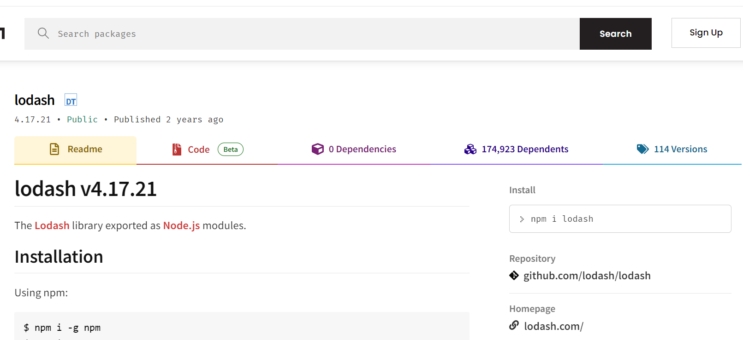
Managing Node Packages
Notes:
A data structure is a particular way of organizing data in a computer so that it can be used effectively.

Slide 7
NodeJS Example
const http = require('http');
const hostname = '127.0.0.1';
const port = 3000;
const server = http.createServer((req, res) => {
res.statusCode = 200;
res.setHeader('Content-Type', 'text/plain');
res.end('Hello World');
});
server.listen(port, hostname, () => {
console.log(`Server running at http://${hostname}:${port}/`);
});
Notes:
A data structure is a particular way of organizing data in a computer so that it can be used effectively.

Slide 8
References
https://nodejs.dev/en/learn/#an-example-nodejs-application
https://nodejs.org/en/docs/guides/blocking-vs-non-blocking
https://nodejs.org/en/docs/guides/event-loop-timers-and-nexttick
https://nodejs.org/en/docs/guides
Notes:
A data structure is a particular way of organizing data in a computer so that it can be used effectively.

Slide 9


Questions and Answers

Slide 10
Thank You!

